Slide 1


George Patsias
28-09-2025

Slide 2

Outline
Executive Summary
Introduction
Methodology
Results
Conclusion

Slide 3
Executive Summary
Objective
Estimate landing probability to support pricing / bid risk.
Top Findings
Success improved post-2017; payload / orbit matter; site differences narrowed.
Headline Metric
Model achieves ~83% accuracy on held-out data.
Business Impact
Enables sharper pricing while reducing downside risk on challenging profiles.
So What?
Supports risk-aware, competitive proposals.

Slide 4
Why: First-stage landing underpins SpaceX’s cost advantage; forecasting success supports better pricing and risk.
Questions:
How has success changed over time/sites?
Which factors matter most?
Can we predict success reliably?
Scope: Falcon 9 orbital launches, 2010–2020; focus on pre-launch factors (orbit, payload, site, reuse).
Deliverables: Clear EDA, interactive map/dashboard, and a predictive baseline for landing probability.
Introduction

Slide 5
Data Collection Methodology
Sources
SpaceX REST API (launches/rockets/payloads) + Wikipedia pages (launch sites/orbit context).
Scope
Falcon 9 orbital launches, 2010–2020; exclude Falcon 1 and tests without usable metadata.
Access Pattern
requests → JSON → pandas.json_normalize → tabular; Wikipedia via requests + BeautifulSoup.
Keys Used to Join
flight_number, rocket.id, payloads[].id, launchpad.id.
Quality Checks
Record counts by year/site, null-rate audit per field, cross-check site/orbit text vs API.
Reproducibility
Parameterized notebooks + cached raw JSON; deterministic seeds and version-pinned libs.

Slide 6

Data Wrangling & Feature Engineering Methodology
Cleaning: Drop Falcon 1; coerce types (dates → datetime, masses → numeric); trim/standardize categorical text.
Target: Class ∈ {0,1} (landing outcome consolidated from outcome strings).
Core Features: Orbit, LaunchSite, PayloadMass, FlightNumber, Flights, GridFins, Legs, Reused, ReusedCount, LandingPad, Block, Year.
Derivations: Orbit grouping (e.g., LEO/GTO/ISS), payload bands, year/month, reuse indicators from booster history.
Missing & Outliers: Impute rare categorical levels as “Other”; keep payload outliers (true missions) but cap for EDA visuals.
Model Matrix: One-hot encode (Orbit, LaunchSite, LandingPad, Serial); scale numerics for LR/SVM; export dataset_part_3.csv.

Slide 7
EDA Methodology
Questions framed (trends, drivers, site/orbit differences)
Groupby/pivot/value_counts + SQL cross-checks
Key visuals (scatter, bar, yearly trend)
Minimal imputation; outliers kept (cap only for display)
Reproducibility notes (notebook sections, saved figures)

Slide 8
Tools: Folium (MarkerCluster) + Plotly Dash
Inputs: Launch Site dropdown, Payload Mass slider
Outputs: Success pie (by site), Payload vs Success scatter (orbit hue)
Callbacks: inputs → filtered data → figures; handles empty states
UX: clear titles/legends, hover, responsive layout
Validation: interactive counts align with static EDA
Interactive Visual Analytics Methodology

Slide 9

Predictive Analysis Methodology
Target and Features (landing success; payload, orbit, site, reuse, etc.)
Train/Test Split (80/20, stratified, fixed seed)
Preprocessing (standardize numerics for LR/SVM; one-hot categoricals)
Models Compared (LogReg, SVM, Decision Tree, k-NN)
Hyperparameter Tuning with GridSearchCV (cv=10)
Evaluation (CV accuracy, test accuracy, confusion matrix)
Sanity Checks (CV vs test consistency; feature effects)

Slide 10
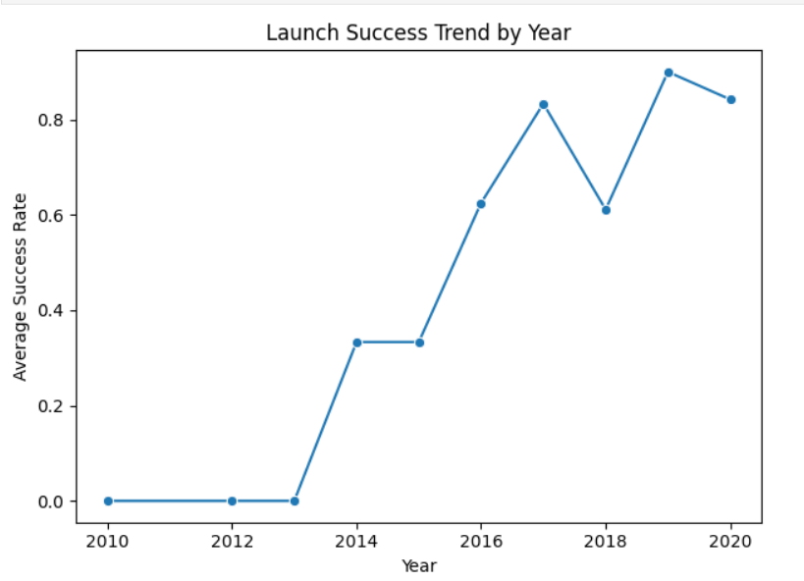
EDA with Data Visualisation Results 1
Launch Success Trend by Year
Key Takeaway: Success rates climbed sharply after 2017, stabilizing around 80–90% by 2019–2020.
Risk dropped after 2017; newer missions priced confidently.
Average success rate by year—clear post-2017 inflection.

Slide 11
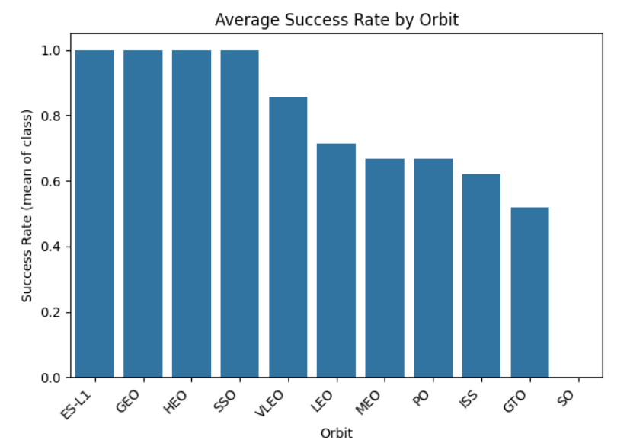
EDA with Data Visualisation Results 2
Success Rate by Orbit (mission profile risk)
Key Takeaway: Risk varies by orbit: GTO and ISS historically lower; ES-L1/GEO/HEO near perfect in this sample.
Risk dropped after 2017; newer missions priced confidently.
Mean success rate by orbit - mission profile matters

Slide 12
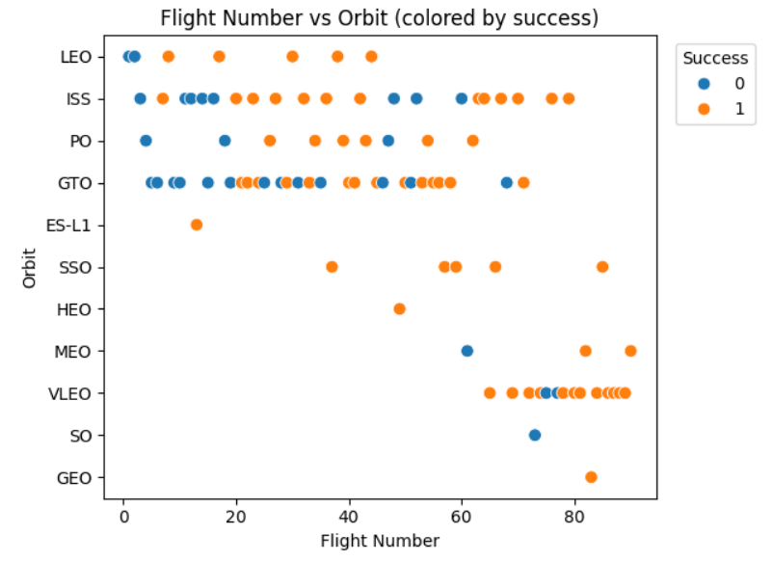
EDA with Data Visualisation Results 3
Payload Mass vs Orbit (colored by outcome)
Key Takeaway: Heavier payloads in tougher orbits (e.g., GTO/VLEO bands here) correlate with lower success.
Risk dropped after 2017; newer missions priced confidently.
Within-orbit weight pockets show outcome shifts.

Slide 13
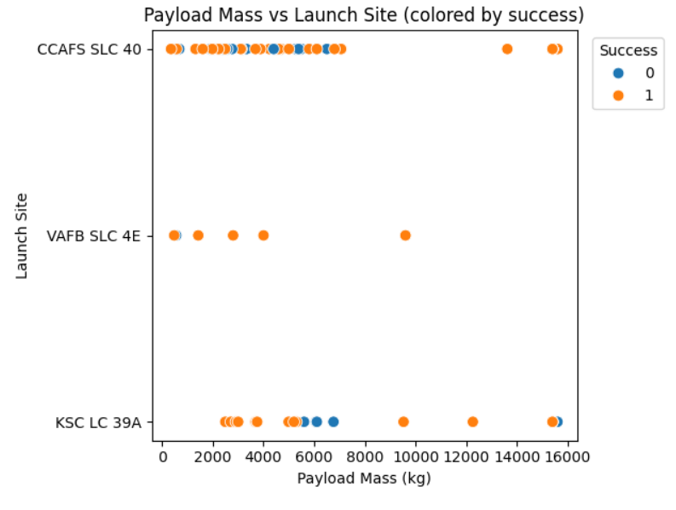
EDA with Data Visualisation Results 4
Site Patterns: Volume vs. Payload Mix
Key Takeaway: SSite differences narrow over time; CCAFS SLC-40 carries the most volume; KSC handles heavier payloads with mixed outcomes.
Mix > site: 40 volume, 39A heavy, 4E mid/few
Payload mix by site explains outcome patterns

Slide 14

EDA with SQL Results 1
SQL Data Model & Staging
How many records did we analyse?
SELECT COUNT(*) AS n_rows,
MIN(date) AS min_date,
MAX(date) AS max_date
FROM launches;
We analyse N flights, from min_date to max_date.

Slide 15

EDA with SQL Results 2
Data Quality Checks
Basic Data Quality (SQL)
SELECT
SUM(CASE WHEN orbit IS NULL THEN 1 ELSE 0 END) AS null_orbit,
SUM(CASE WHEN launch_site IS NULL THEN 1 ELSE 0 END) AS null_site,
SUM(CASE WHEN payload_mass_kg IS NULL THEN 1 ELSE 0 END) AS null_payload
FROM launches;
SELECT flight_number, COUNT(*)
FROM launches
GROUP BY flight_number
HAVING COUNT(*) > 1;
No/limited nulls; no duplicate flight numbers found (or removed X duplicates).

Slide 16

EDA with SQL Results 3
Yearly Launches & Success Rate
Yearly Activity & Success (SQL aggregation)
SELECT year,
COUNT(*) AS launches,
SUM(class) * 1.0 / COUNT(*) AS success_rate
FROM launches
GROUP BY year
ORDER BY year;
Success rose sharply after 2017, reaching ~0.8–0.9

Slide 17
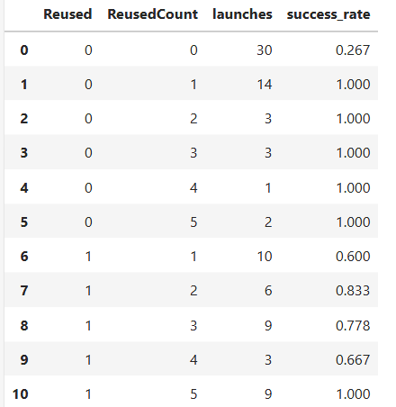

EDA with SQL Results 4
Impact of Reuse
Reuse & Learning Effects
SELECT reused,
reusedcount,
COUNT(*) AS launches,
ROUND(AVG(class), 3) AS success_rate
FROM launches
GROUP BY reused, reusedcount
ORDER BY reused, reusedcount;
Higher reuse counts tend to track with higher success - evidence of learning & hardware maturity.

Slide 18
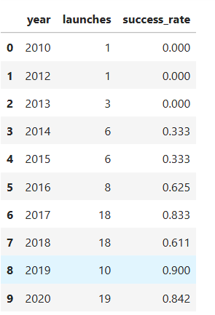
EDA with SQL Results 5
Yearly Launches & Success Rate (SQL)
Falcon 9 Landings: Scale & Reliability (2010–2020)
SELECT year,
COUNT(*) AS launches,
ROUND(SUM(class) * 1.0 / COUNT(*), 3) AS success_rate
FROM launches
GROUP BY year
ORDER BY year;
Scope: 101 Falcon 9 launches analyzed (2010–2020).
Cadence: Annual launches grew 1 → 19 (~19× in a decade).
Reliability: Landing success rose 0.00 → 0.84, peaking at 0.90 in 2019.
Year vs. Success Rate)

Slide 19
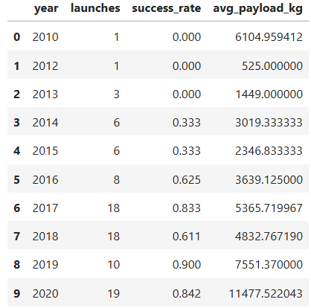
EDA with SQL Results 6
Heaviest Failures (Top 10)
Where failures were most costly (mass proxy)
SELECT date, launch_site, orbit, payload_mass_kg
FROM launches
WHERE class = 0
ORDER BY payload_mass_kg DESC
LIMIT 10;
A few heavy-payload failures cluster in GTO/upper bands.

Slide 20
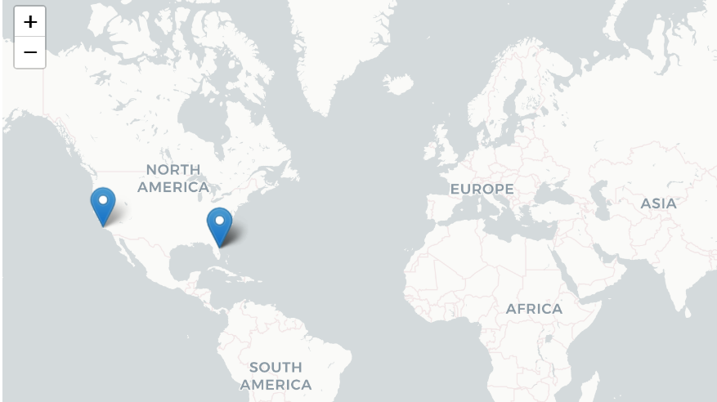
Interactive Map (Folium) - Code & Output
import folium, pandas as pd sites = [ ("SLC-40", 28.561857, -80.577366), ("LC-39A", 28.608389, -80.604333), ("SLC-4E", 34.632834, -120.610746), ] df = pd.DataFrame(sites, columns=["site","lat","lon"]) m = folium.Map(location=[30,-95], zoom_start=4, tiles="CartoDB positron") for _, r in df.iterrows(): folium.Marker([r.lat, r.lon], tooltip=r.site).add_to(m) m.save("interactive_launch_map.html")
Launch pad map: SLC-40/LC-39A and SLC-4E plotted; baseline for orbit/payload layers.

Slide 21
Predictive Analysis Results Overview
Objective: predict booster landing; compare Logistic Regression, SVM, Decision Tree, and KNN.
Test set size: 18

Slide 22
Predictive Analysis Summary Model Comparison - Key Takeaways
Top Accuracy: Logistic Regression & SVM = 0.83 (15/18 correct).
Both prioritize recall for 'landed' (Recall=1.00) but low specificity (0.50) → more false alarms.
Decision Tree & KNN are more balanced (Specificity=0.67; Recall=0.83) but lower accuracy (0.78).
Business Fit: if missing a landing is costly, prefer LR/SVM; if false alarms are costly, prefer Tree/KNN or tune threshold.
Next: threshold tuning, class weights, calibration, and feature enrichment (orbit × payload, site, year).

Slide 23
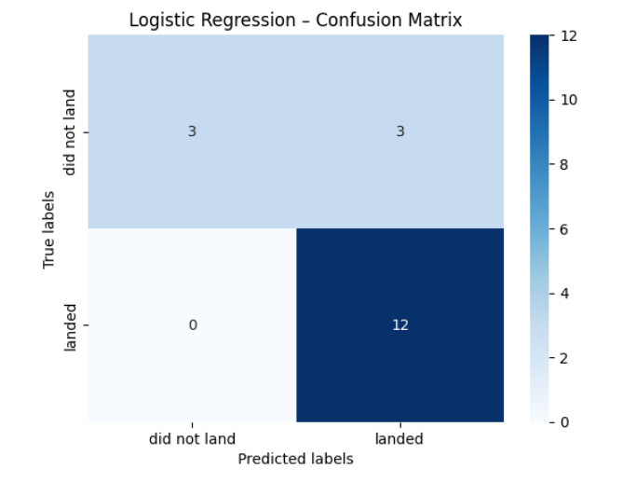
Predictive Analysis Results 1 Logistic Regression - Confusion Matrix
Key Metrics
Accuracy: 0.83
Precision (landed): 0.80
Recall (landed): 1.00
Specificity (did not land): 0.50
F1 (landed): 0.89
Notes: Zero missed landings (FN=0); 3 false positives on 'landed' (over-optimistic).

Slide 24
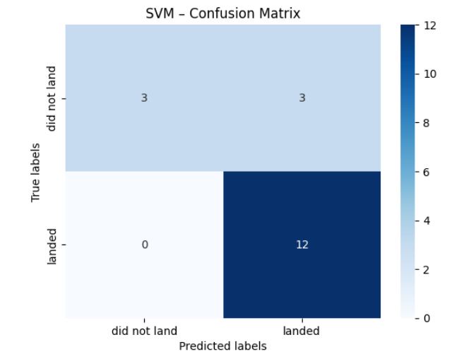
Predictive Analysis Results 2 SVM - Confusion Matrix
Key Metrics
Accuracy: 0.83
Precision (landed): 0.80
Recall (landed): 1.00
Specificity: 0.50
F1 (landed): 0.89
Notes: Pattern mirrors Logistic Regression; strong recall, weaker negative class discrimination.

Slide 25
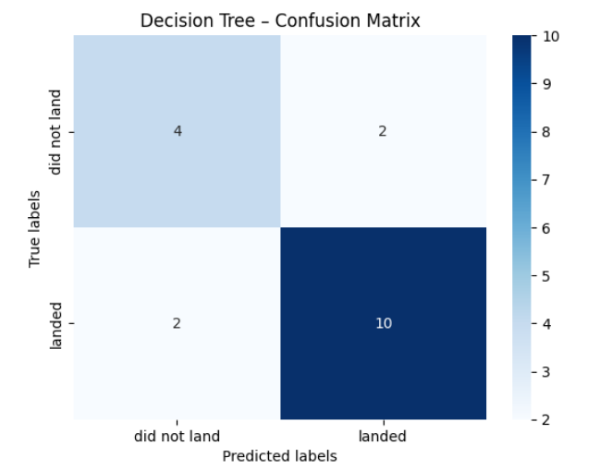
Predictive Analysis Results 3 Decision Tree - Confusion Matrix
Key Metrics
Accuracy: 0.78
Precision (landed): 0.83
Recall (landed): 0.83
Specificity: 0.67
F1 (landed): 0.83
Notes: More balanced errors (FP=2, FN=2); slightly lower overall accuracy but fewer false alarms.

Slide 26
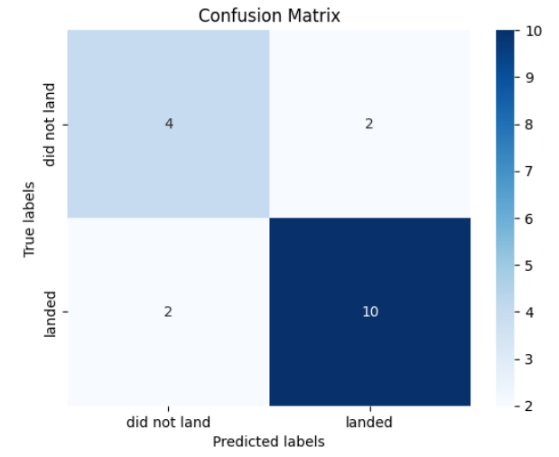
Predictive Analysis Results 4 KNN - Confusion Matrix
Key Metrics
Accuracy: 0.78
Precision (landed): 0.83
Recall (landed): 0.83
Specificity: 0.67
F1 (landed): 0.83
Notes: Performance similar to Decision Tree; balanced but less accurate than LR/SVM on this split.

Slide 27

Conclusion
We can now quantify landing likelihood and its drivers - turning historical launch records into actionable pricing and risk insights.
Objectives Met
Built a reproducible pipeline to predict first-stage landing success and surface the drivers (orbit, payload, site, flight maturity).
Key Findings
Success climbed sharply after 2017; heavier/GTO missions are harder; site differences have narrowed; flight number (experience) matters.
Modelling Result
Simple classifiers (best = Linear SVM) achieve ~83–90% held-out accuracy with few false positives—useful for pricing & bid risk.
Business Impact
Enables evidence-based launch pricing, scenario analysis by mission type, and competitive bids for alternate providers.
Limitations
Modest sample size; public data noise; payload/mission details partially observed (e.g., exact landing method, weather).
What’s Next
Add booster age/propellant margins, weather/sea-state, and landing method; calibrate probabilities; deploy a lightweight Dash app + scheduled data refresh.

Slide 28


